Slide 1

Table of contents
Abstract
Introduction
Literature Survey
Inference from the survey
Objective of the Project
Architecture diagram
Modules Description
Algorithms used
Screen shot of the project
Conclusion
References

Slide 2
ABSTRACT
The Minimalist Retail Management System Mini Project represents a pioneering effort to revolutionize retail management solutions, particularly targeting the needs of small and medium-sized enterprises (SME’s). In response to the complexities inherent in existing retail management systems, this project adopts a minimalist design philosophy, streamlining functionalities to essential components. The system aims to offer a user-friendly, cost-effective, and adaptable solution for retailers while avoiding unnecessary complexities.
As the retail landscape undergoes dynamic changes, SME’s face unique challenges in adopting and implementing traditional retail management systems. These challenges include steep learning curves, resource-intensive implementations, and feature-rich systems that may exceed operational requirements. This project introduces a paradigm shift by embracing a minimalist design philosophy to create an intuitive, efficient, and accessible retail management system. The system prioritizes essential functionalities while eliminating unnecessary complexities, catering specifically to the needs of SME’s.

Slide 3
INTRODUCTION
The motivation behind the creation of MRMS stems from the inherent challenges faced by SMEs in adopting and leveraging traditional retail management systems. As retail environments evolve, the need for accessible, efficient, and tailored solutions becomes increasingly evident. The motivation is rooted in the desire to empower SMEs with a system that aligns with their scale, operational nuances, and growth aspirations.
Within the dynamic landscape of retail, effective management is pivotal for business success. However, traditional retail management systems often present challenges, especially for SMEs. This introduction delves into the difficulties faced by smaller retailers, emphasizing the need for a minimalist approach to address their unique operational requirements. It sets the stage for the project's exploration of a solution that prioritizes simplicity and functionality.

Slide 4
LITRATURE SURVEY
S.No | NAME | YEAR | METHOD USED | MERITS | DEMERITS
1 | A Study on User Acceptance of Minimalist Retail Management Systems | 2020 | Employs a quantitative approach, utilizing surveys and user acceptance models to assess the usability and acceptance of Minimalist Retail Management Systems among small and medium-sized enterprises . The research evaluates factors influencing user satisfaction, ease of use, and perceived usefulness. | Quantitative data provides statistically significant insights. Identifies key factors influencing user acceptance, aiding system refinement. | May not capture qualitative nuances in user experiences. Limited generalizability if the study focuses on a specific industry or region.
2 | Technical Evaluation of Minimalist Retail Management System | 2021 | Research takes a technical perspective, conducting an in-depth evaluation of the architecture and performance of MRMS. The study employs benchmarking techniques, analyzing system responsiveness, scalability, and resource efficiency. The goal is to provide insights into the technical merits and limitations of MRMS. | Offers a technical understanding of MRMS, aiding developers and system architects. Benchmarks provide quantitative measures for system performance. | May lack insights into user experience and practical usability. Limited generalizability if the technical evaluation focuses on specific technology stacks.
3 | Adoption Challenges and Success Factors of Minimalist Retail Management Systems in SMEs | 2019 | Takes a qualitative approach, employing interviews and case studies to explore the challenges and success factors in the adoption of MRMS by SMEs. The research delves into organizational readiness, change management strategies, and contextual factors influencing the successful implementation of minimalist retail systems. | Qualitative insights offer a rich understanding of adoption challenges. Case studies provide real-world context and applicability. | Limited to specific industries or regions covered by the case studies. May lack quantitative data for broader generalizability.

Slide 5
INFERENCE FROM THE SURVEY
User Acceptance and Satisfaction: The first survey focused on user acceptance, utilizing quantitative methods to gauge user satisfaction, ease of use, and perceived usefulness. The inference is that understanding and addressing user needs and preferences are crucial for the success of MRMS. This insight can guide further refinements in the system's user interface and overall user experience.
Technical Merits and Limitations: The second survey delved into the technical aspects of MRMS, providing an in-depth evaluation of its architecture and performance. The inference suggests that while technical robustness is essential, a comprehensive understanding of the system's technical intricacies can inform developers and architects, guiding improvements and optimizations.
Adoption Challenges and Success Factors: The third survey focused on adoption challenges and success factors, utilizing qualitative methods such as interviews and case studies. The inference is that successful implementation of MRMS in SMEs requires attention to organizational readiness, change management strategies, and contextual factors. This insight is valuable for guiding businesses in the adoption process.

Slide 6
OBJECTIVE
The primary objective of the MRMS Mini Project is to pioneer a minimalist retail management solution that addresses the specific needs of SMEs. By prioritizing simplicity and functionality, the system aims to streamline essential retail operations—inventory management, sales tracking, and customer relations. This objective is driven by the vision to provide SMEs with a user-friendly, cost-effective, and easily adaptable retail management tool.

Slide 7
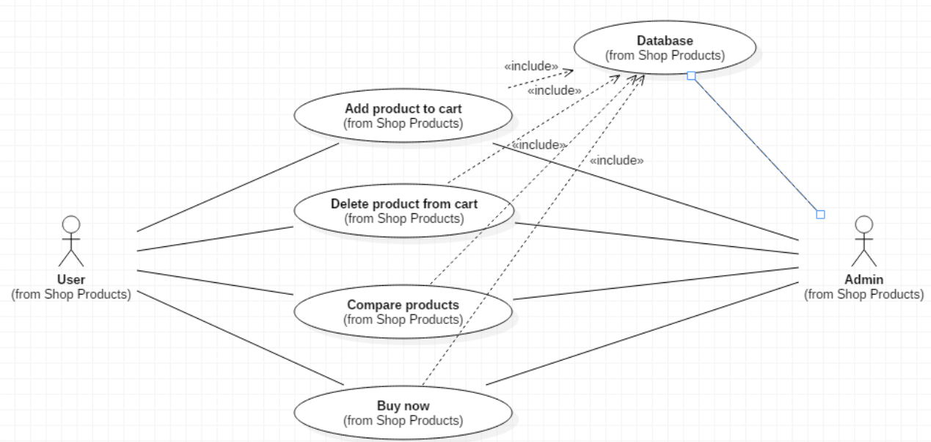
ARCHITECTURE

Slide 8
MODULE DESCRIPTION
User Interface (UI) Module:
Description: The User Interface module is responsible for the graphical representation and interaction with the users. It utilizes Tkinter to create a simple and intuitive interface, allowing users to navigate through the system effortlessly. This module includes buttons and labels that trigger specific actions, such as employee and admin functionalities.
Employee Module:
Description: The Employee module handles the functionalities related to employee roles within the retail management system. It includes actions like managing employee data, handling employee-specific operations, and facilitating communication between the user interface and the employee-related functionalities. The emp function is triggered when an employee-specific button is clicked, redirecting the user to the employee module.
Admin Module:
Description: The Admin module is responsible for functionalities specific to administrative roles. It includes actions like managing inventory, processing sales, and overseeing overall system operations. The ‘adm’ function is triggered when an admin-specific button is clicked, redirecting the user to the admin module. This module interfaces with the core functionalities of the retail management system.

Slide 9
MODULE DESCRIPTION
Exit Module:
Description: The Exit module handles the graceful termination of the application. It prompts users with a confirmation dialog to ensure that they intend to exit the system. The ‘Exit’ function is linked to the main window's close button, ensuring a controlled shutdown of the application.
Image Loading Module:
Description: The Image Loading module is responsible for loading and displaying images within the user interface. It includes code to load images (e.g., background images for buttons) and display them in specific regions of the application window. This module contributes to the visual appeal of the system.
Main Loop Module:
Description: The Main Loop module contains the primary execution loop of the application. It keeps the application running until the user decides to exit. The ‘mainloop’ function ensures continuous interaction with the user interface and handles events triggered by user actions

Slide 10
MODULE DESCRIPTION
Image Files Module:
Description: The Image Files module stores file paths for images used in the user interface. It includes paths to images such as the main background image and button icons. This module centralizes image file paths for easy maintenance and updates.
Application Initialization Module:
Description: The Application Initialization module sets up the main window of the application. It defines the size, title, and other properties of the main window. This module ensures the initial configuration and appearance of the application.
Database Interaction Module:
Description: The Database Interaction module is responsible for managing the interaction between the Minimalist Retail Management System and the underlying relational database. This module ensures the storage, retrieval, and manipulation of data essential for the system's operation, including employee information, inventory details, and transaction records.

Slide 11
ALGORITHMS
Inventory Management Algorithms:
Description: Inventory management often involves algorithms for handling stock levels, reordering, and restocking. Algorithms such as Economic Order Quantity (EOQ) or reorder point algorithms might be used to optimize inventory levels and reduce holding costs.
Sales Processing Algorithms:
Description: For processing sales transactions, algorithms could be employed to calculate total costs, apply discounts, and update inventory levels. Pricing algorithms and discount calculation formulas might be used to determine the final amount payable by the customer.
Employee Management Algorithms:
Description: If there were features related to employee management in the system, algorithms for tasks like attendance tracking, payroll calculation, and performance evaluation might be implemented. These algorithms would ensure accurate and efficient management of employee-related data.

Slide 12
ALGORITHM
Data Validation Algorithms:
Description: While not explicitly mentioned, data validation is a critical aspect of any system. Algorithms for data validation would be used to ensure that user inputs are accurate, complete, and conform to predefined criteria. For instance, algorithms might validate that numeric fields contain only numbers, or dates are in the correct format.
Sorting Algorithms:
Description: If there were functionalities involving the display or manipulation of lists (e.g., employee lists, inventory items), sorting algorithms like quicksort or mergesort might be employed to efficiently organize and present the data.
Search Algorithm:
Description: For systems with large datasets, search algorithms such as binary search or linear search might be implemented to quickly locate specific items or records.
Transaction Recording Algorithms:
Description: If there were a need for recording and processing transactions, algorithms might be used to ensure the consistency and accuracy of transaction records. This could involve validation checks and error-handling algorithms.

Slide 13
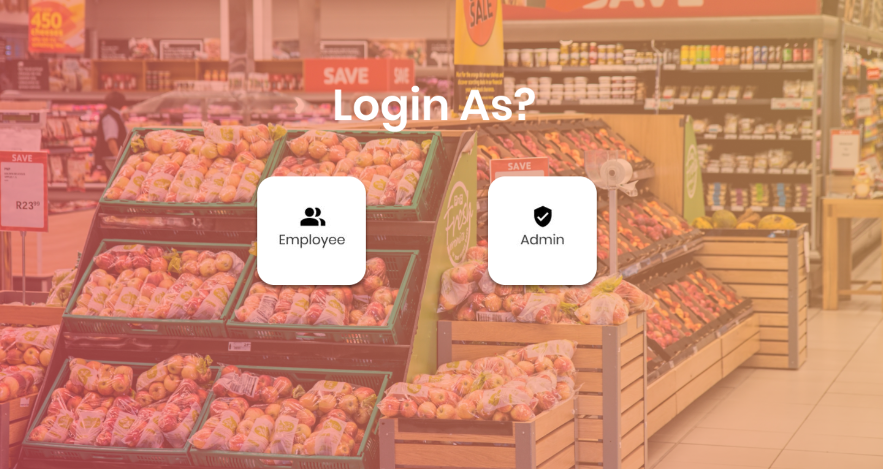
SCREEN SHOTS OF THE PROJECT

Slide 14
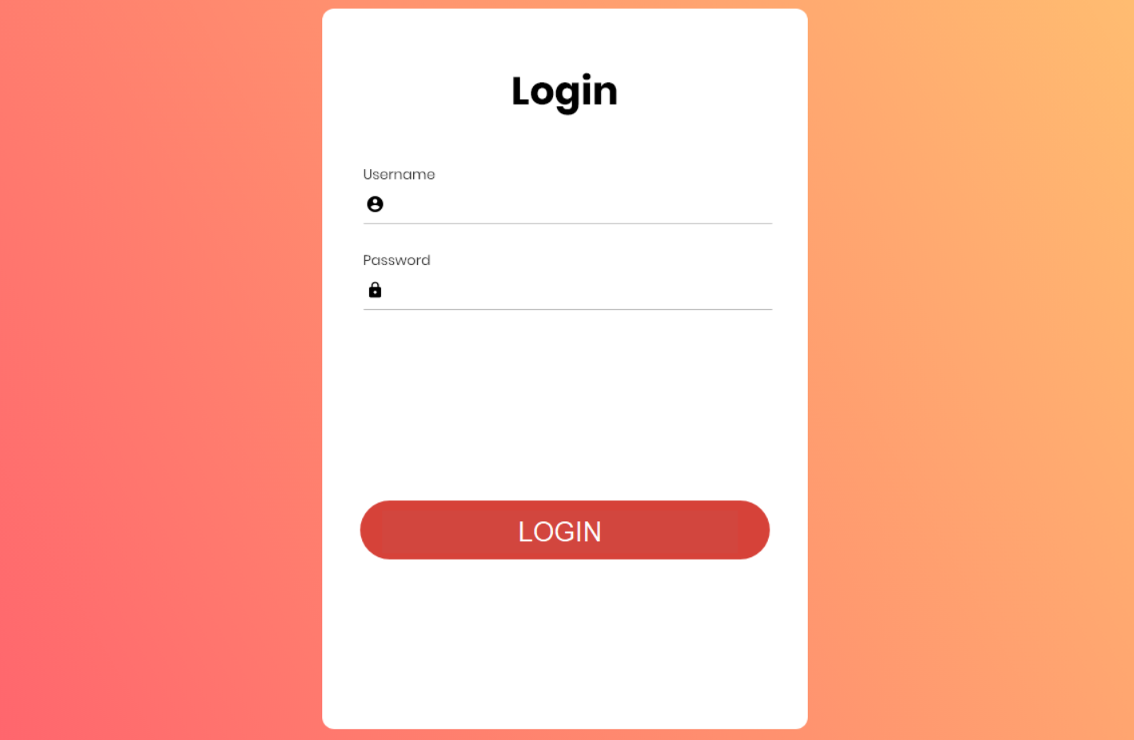
SCREEN SHOTS OF THE PROJECT

Slide 15
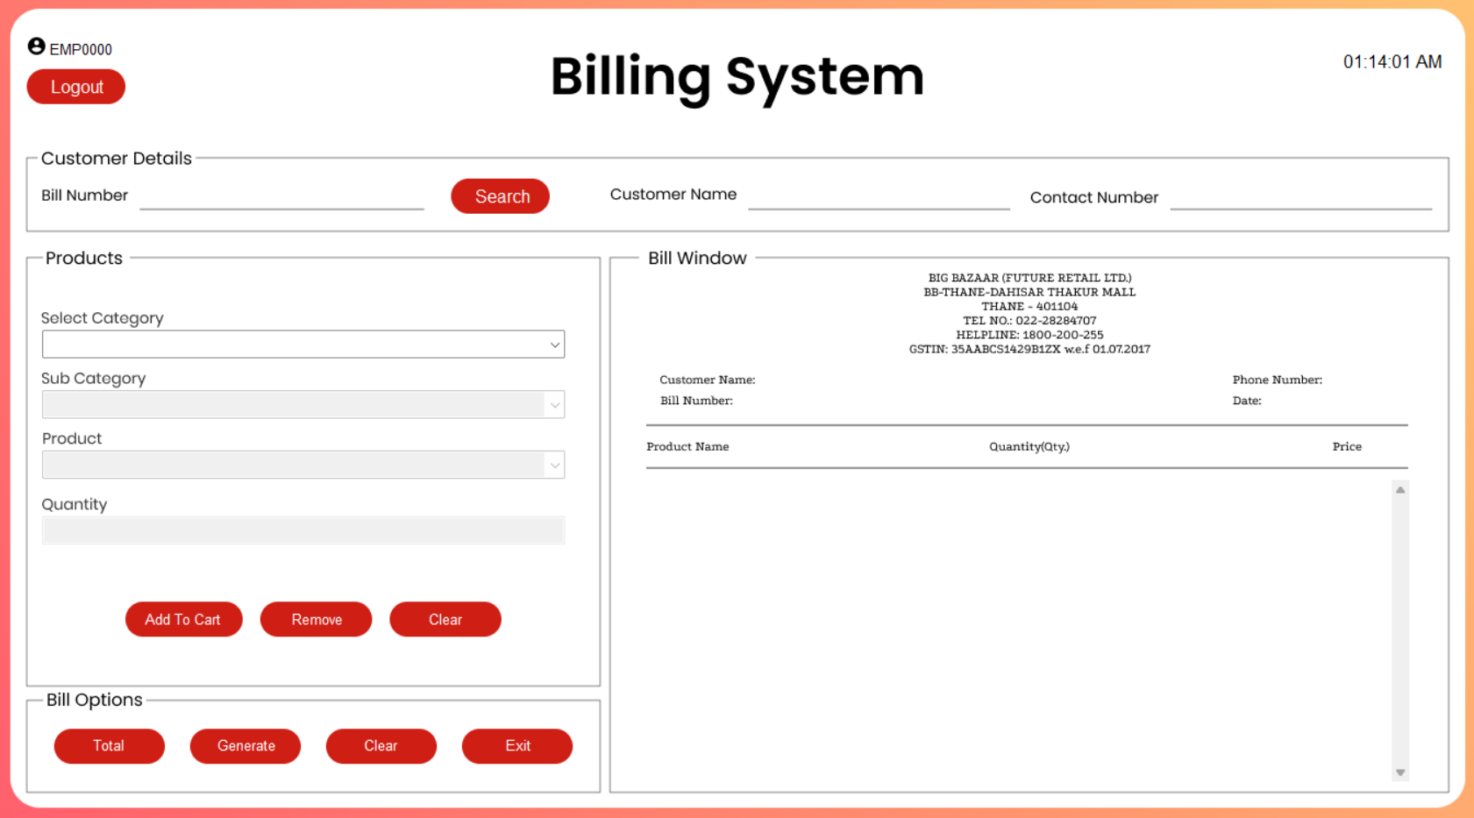
SCREEN SHOTS OF THE PROJECT

Slide 16
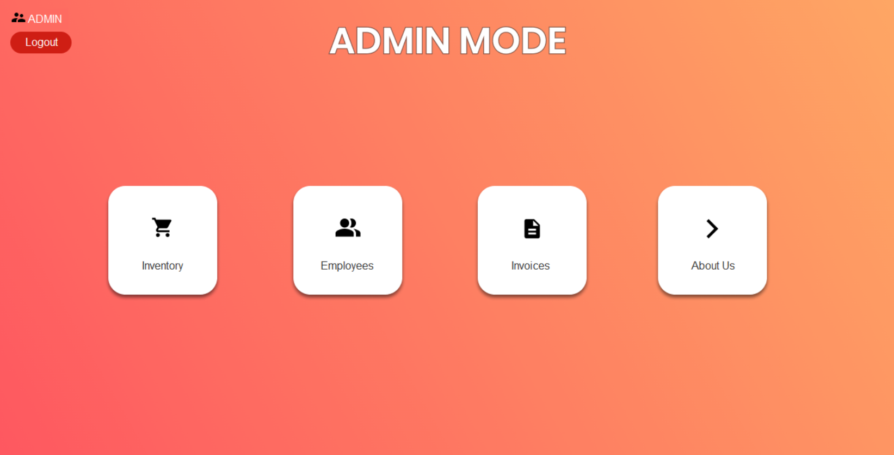
SCREEN SHOTS OF THE PROJECT

Slide 17
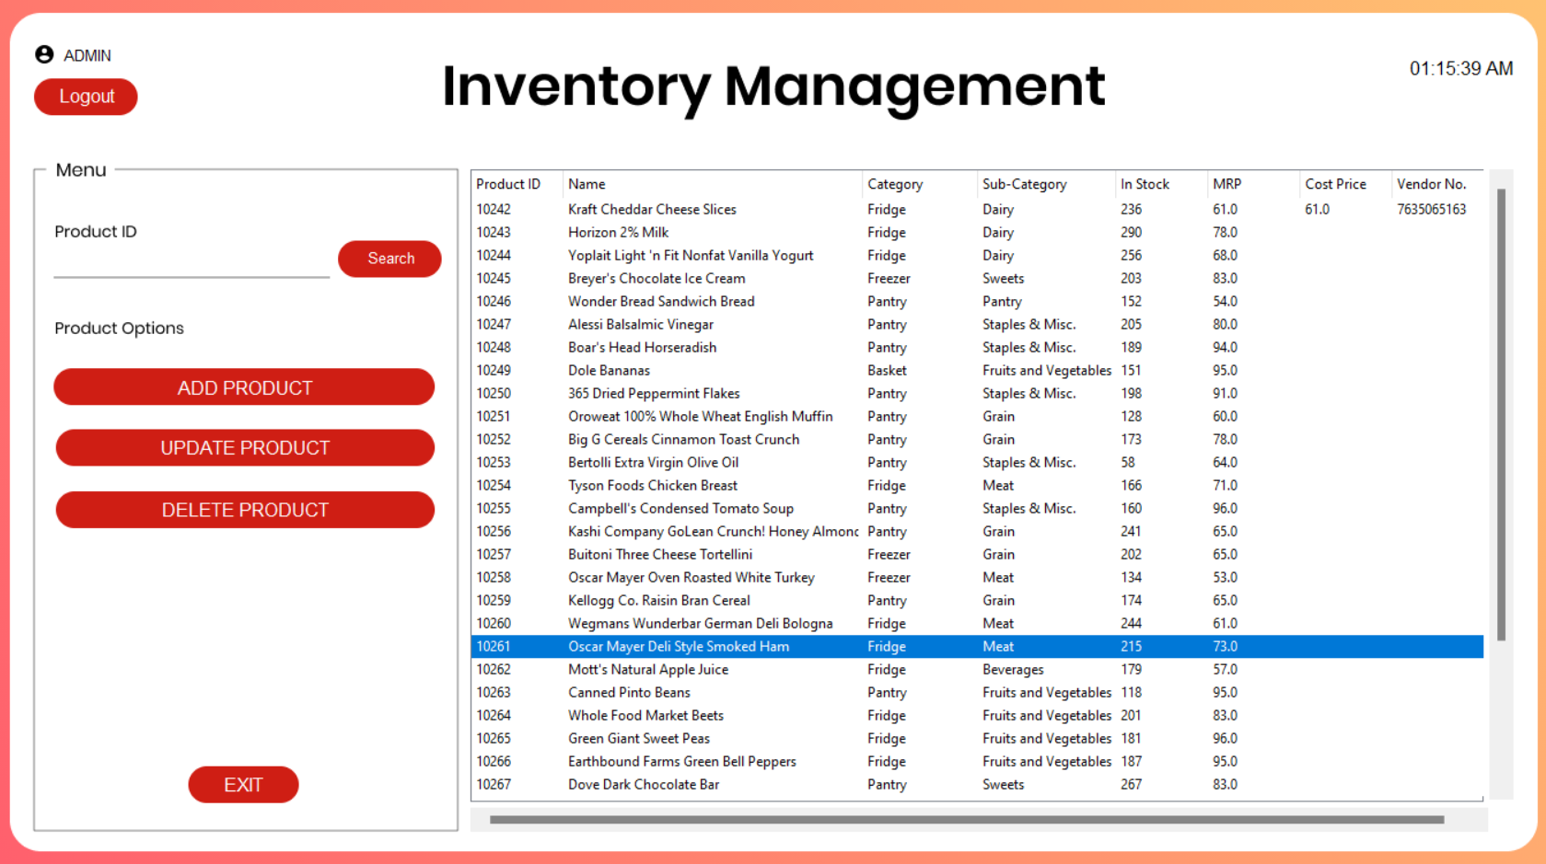
SCREEN SHOTS OF THE PROJECT

Slide 18
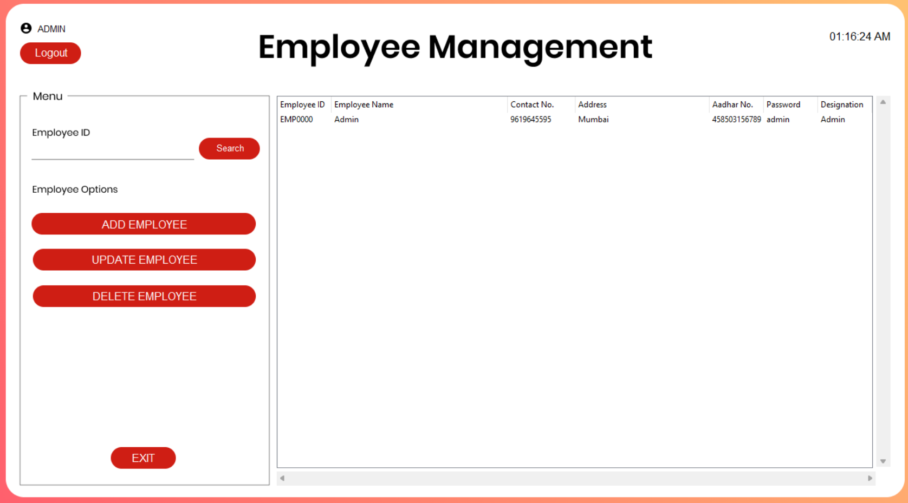
SCREEN SHOTS OF THE PROJECT

Slide 19
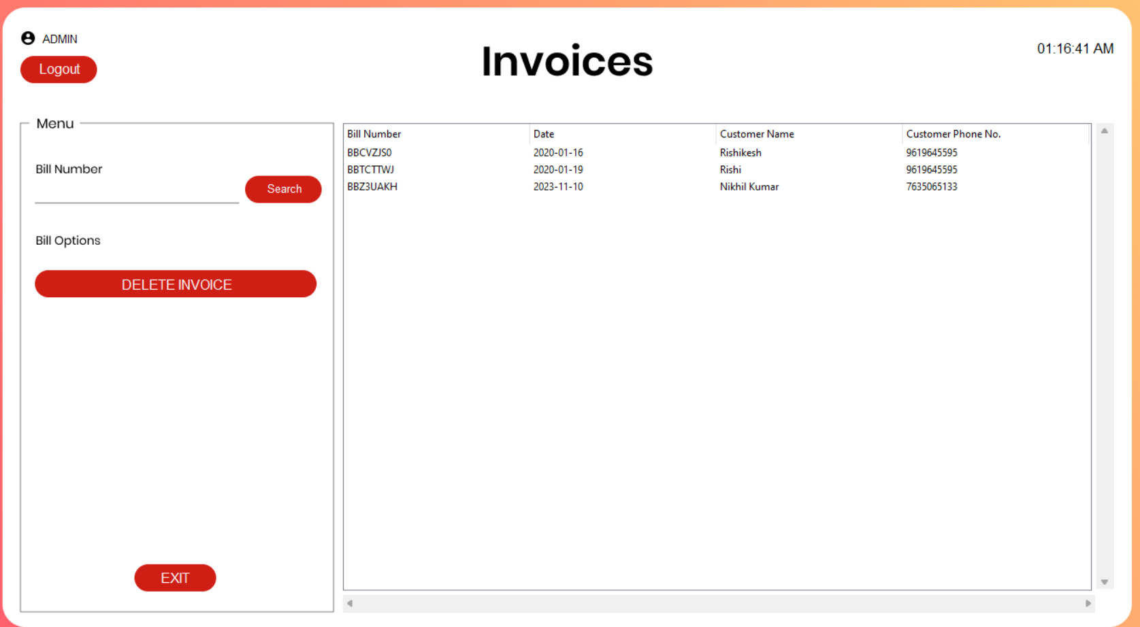
SCREEN SHOTS OF THE PROJECT

Slide 20
CONCLUSION
The development of the Minimalist Retail Management System (MRMS) has been a journey aimed at redefining the landscape of retail management, particularly for small and medium-sized enterprises (SMEs). The project's foundation was rooted in the acknowledgment of the challenges faced by SMEs in adopting traditional retail management systems, and the conclusion marks the culmination of efforts to address these challenges through a minimalist approach.
In conclusion, the minimalist design has proven to be a pivotal aspect of the project's success. By distilling functionalities to their essence, MRMS provides SMEs with an intuitive and accessible retail management solution. The streamlined functionality ensures that users can navigate the system with ease, focusing on essential tasks without being encumbered by unnecessary features.

Slide 21
Reference
https://www.geeksforgeeks.org/python-programming-language/
https://www.tutorialspoint.com/python/index.htm
https://www.ieee.org/
https://www.studocu.com/in/document/bharati-vidyapeeth-university/bachler-of-computer-application/tkinter-brief-intro-about-thinter/42719190
https://www.w3schools.com/sql/

